Slide 1

Team Details
Team name – Bit-Manipulators
Team leader name – Jayesh Muley
Problem Statement – Sustainable AI & Green Tech

Slide 2

Project Name: EcoLoop Headline: The NPU-Native Circular Economy Agent
The Concept:
EcoLoop is a decentralized "Green AI" platform that has been designed to close the loop around campus waste management. It allows for a new type of hyperlocal marketplace, where one student's "trash" is another student's "treasure," without the need for cloud computing – a highly energy-intensive activity.
How It Works:
Snap & Identify (Edge AI):
Using the AMD Ryzen AI NPU, it recognizes waste (such as an older motor and/or sensors) directly from the device in real-time.
Match & Upcycle (Local RAG):
On the device, the Agent searches the "Campus Needs" database to quickly find a buyer, e.g., "The Robotics Club needs this motor," or creates a DIY upcycling guide.
Why It Matters:
Unlike other sustainability applications that generate emissions due to heavy cloud GPUs, EcoLoop is 100% locally based. Because of this, EcoLoop offers Zero-Carbon Inference that helps alleviate the issue of physical waste.

Slide 3
Opportunities
How different is it from any of the other existing ideas?
Edge-Native vs. Cloud-Dependent: Unlike standard "Green" apps that ironically burn carbon by sending images to cloud servers, EcoLoop runs 100% locally on the AMD Ryzen AI NPU. This makes our solution carbon-neutral by design.
Active Agent vs. Passive Listing: Existing platforms (like campus forums) wait for users to search. EcoLoop actively pushes matches (e.g., notifying the Robotics Club instantly when a printer motor is scanned).
Privacy-Centric: Since inference happens on the device, no camera feeds or personal data ever leave the student’s phone/laptop.
How will it be able to solve the problem?
Removing Friction: We eliminate the tedious manual data entry of listing items. Computer Vision allows a "One-Snap Solution" that identifies and categorizes waste in milliseconds.
Bridging Information Silos: Labs often buy new parts because they don't know another department is throwing them away. Our Local RAG agent connects these disconnected silos instantly.
Behavioral Nudges: By gamifying the process and showing real-time "CO2 Saved" metrics, we incentivize students to upcycle rather than discard.
USP of the proposed solution
NPU-Powered Sustainability: The only campus waste solution that leverages AMD Ryzen AI to reduce computational energy by ~99% compared to cloud-based alternatives.
The "Circular Agent": It doesn't just identify waste; it generates new utility for it (e.g., generating a DIY guide to turn a fan into a fume extractor).
Zero-Cost Deployment: No expensive server infrastructure is required for the university, making it scalable immediately.

Slide 4
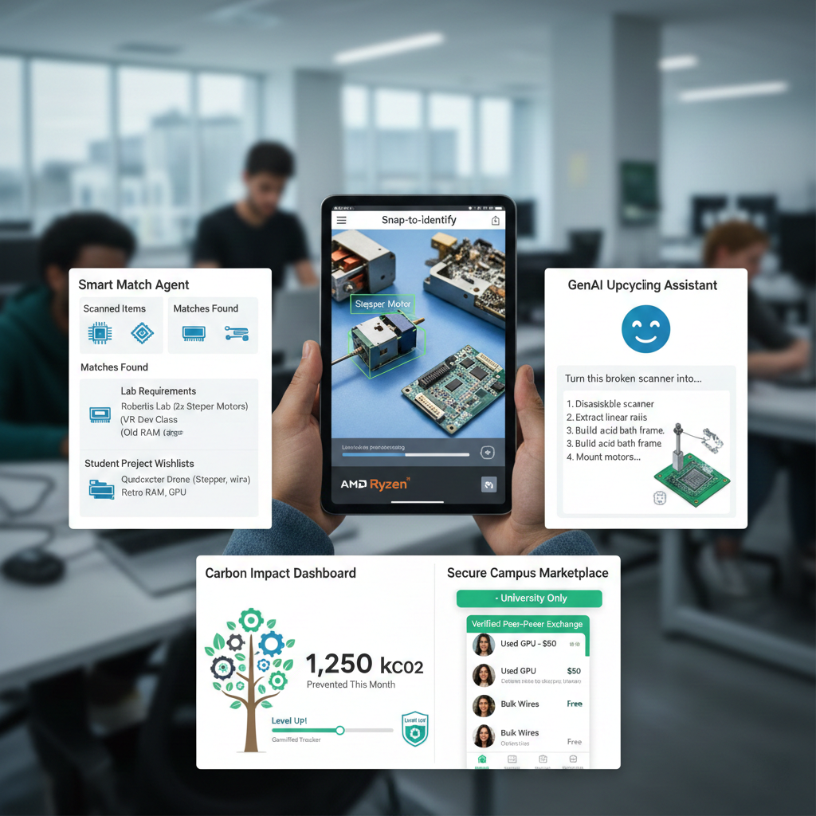
List of features offered by the solution
Snap-to-Identify (NPU Vision):Real-time object detection to identify components of E-Waste, such as "Stepper Motor" or "Old RAM," using local quantized models running on AMD Ryzen NPU.
Smart Match Agent (Local RAG): An intelligent agent that incorporates cross-referencing of scanned items with the 'Lab Requirements' and 'Student Project Wishlist's databases to locate an immediate buyer.
GenAI Upcycling Assistant: For items not having an immediate buyer base, an embedded AI system provides step-by-step DIY instructions (e.g., "Upcycle this old scanner to a PCB etching device").
Carbon Impact Dashboard: It is a gamified dashboard that calculates the amount of CO2 emissions saved by reusing parts instead of purchasing new ones.
Secure Campus Marketplace: A peer-to-peer marketplace that is verified and restricted only to the students of the campus, providing a safe and trusted trade of hardware and scrap.

Slide 5
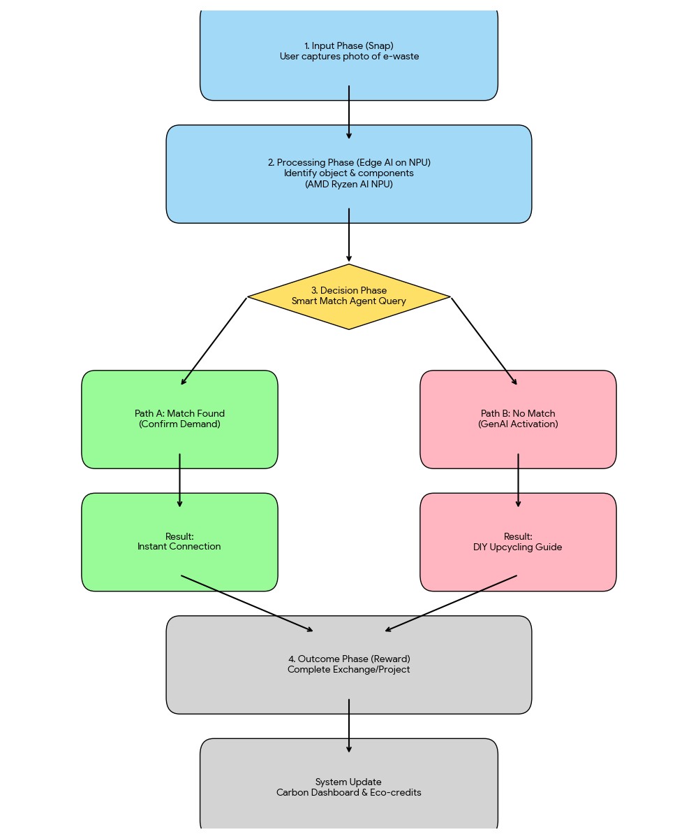
Flow diagram (EcoLoop User Journey)
Input Phase (Snap):
User Action: The student snaps a photo of the e-waste object through the application, like a defective printer or CPU fan.
System: The camera inputs are connected to the local inference engine.
2. Processing Phase (Edge AI on NPU):
Action: In this case, it identifies the object and its reusable parts, which may be described as "Stepper Motor," "Power Supply," etc.
Technology: AMD Ryzen AI NPU runs a Quantized YOLO model to leverage a cloudless detection process.
3. Decision Phase (The Agent):
Action: The "Smart Match Agent" will query the local database.
Path A (Match Found): The database has a match (e.g., "Robotics Club needs Stepper Motor").
Result: Instant Connection.
Path B (No Match): No buyer found.
Result: Generative AIs make it possible to create a "DIY Upcycling Guide" similar to "Transforming this motor into a wind."
4. Outcome Phase (Reward):
User Action: The student finishes the exchange or upcycling project.
System: Updates “Carbon Impact Dashboard” and provides the user with eco-credits.

Slide 6
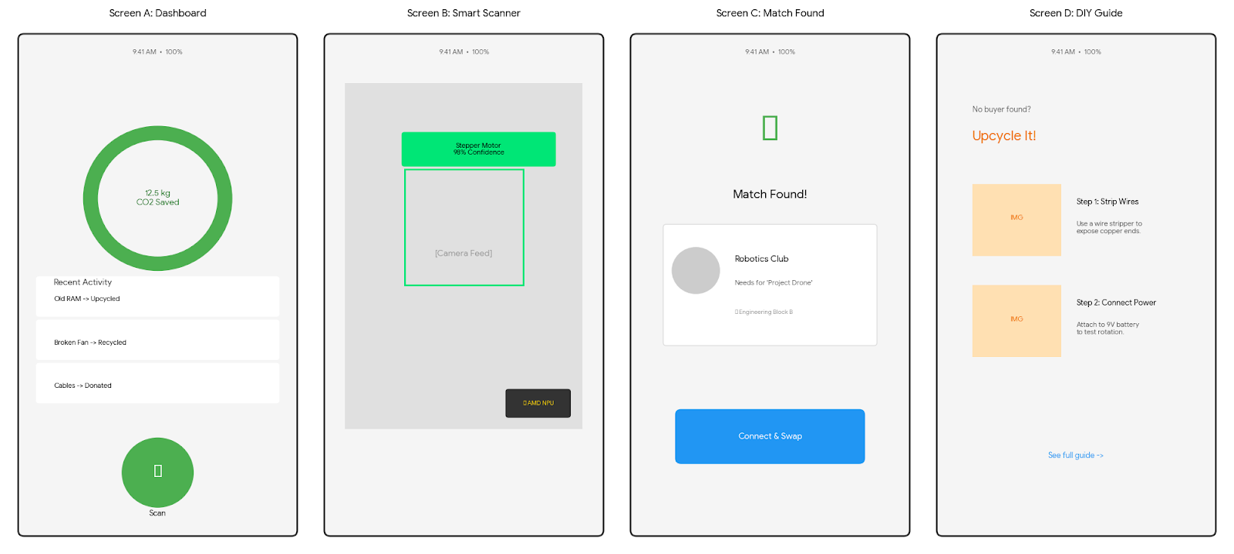
Wireframes

Slide 7
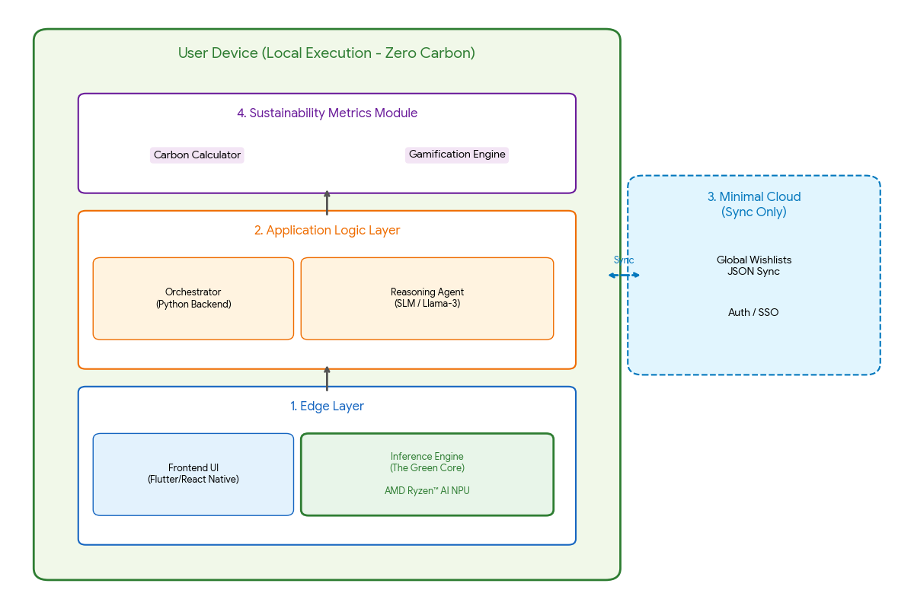
EcoLoop System Architecture
1. Edge Layer (User Device - Laptop/Mobile)
Frontend UI: React Native / Flutter App (Camera Feed & Dashboard).
Inference Engine (The Green Core):
Vision Model: YOLOv8 (Int8 Quantized) using ONNX Runtime Vitis
Hardware: AMD Ryzen™ AI NPU (Zero-Latency).
Local Data Store: Lightweight Vector DB (Chroma DB) for caching local matches.
2. Application Logic Layer (Local)
Orchestrator: Python-based backend, which controls the flow from Vision and RAG.
Reasoning Agent: Small Language Model (SLM) like Phi-3-Mini or Llama-3-8B (Quantized).
Function: Matches "Identified Item" <-> "Campus Needs Database.”
Fallback: Generates DIY tutorials when no results are matched.
3. Data Synchronization Layer (Minimal Cloud)
Sync Service: Periodic JSON Sync of “Campus Wishlist's” and “Global Recycling Rules.”
Identity & Auth: Student secure login (University SSO).
4. Sustainability Metrics Module
Carbon Calculator: Real-time computation of saved CO2 based on the item weight and material.
Gamification Engine: Awards "Eco-Points" and advances user rank.

Slide 8
Technologies to be used in the solution
1. Hardware & Acceleration (The "Green" Enablers)
AMD Ryzen™ AI NPU is the main driver for zero-latency, low-power inference on the edge.
AMD ROCm™ helps optimize and fine-tune SLMs on AMD GPUs before deployment.
2. AI & Machine Learning Models
The goal here is YOLOv8 (Int8 Quantized) for real-time object detection and classification of waste.
Reasoning Agent includes Phi-3-Mini or Llama-3-8B (Quantized) for decision-making and creating upcycling guides.
Inference Runtime uses ONNX Runtime with Vitis AI Execution Provider (EP) for NPU acceleration.
3. Application & Data Layer
The Frontend can be built with React Native or Flutter, which helps create mobile applications for different platforms.
Backend Logic uses Python as the orchestrator for AI agents.
ChromaDB is a local vector database that allows fast offline matching of items to needs.
4. Tools for Sustainability
Carbon SDK is a custom Python module that calculates material weight for real-time CO2 offset.

Slide 9
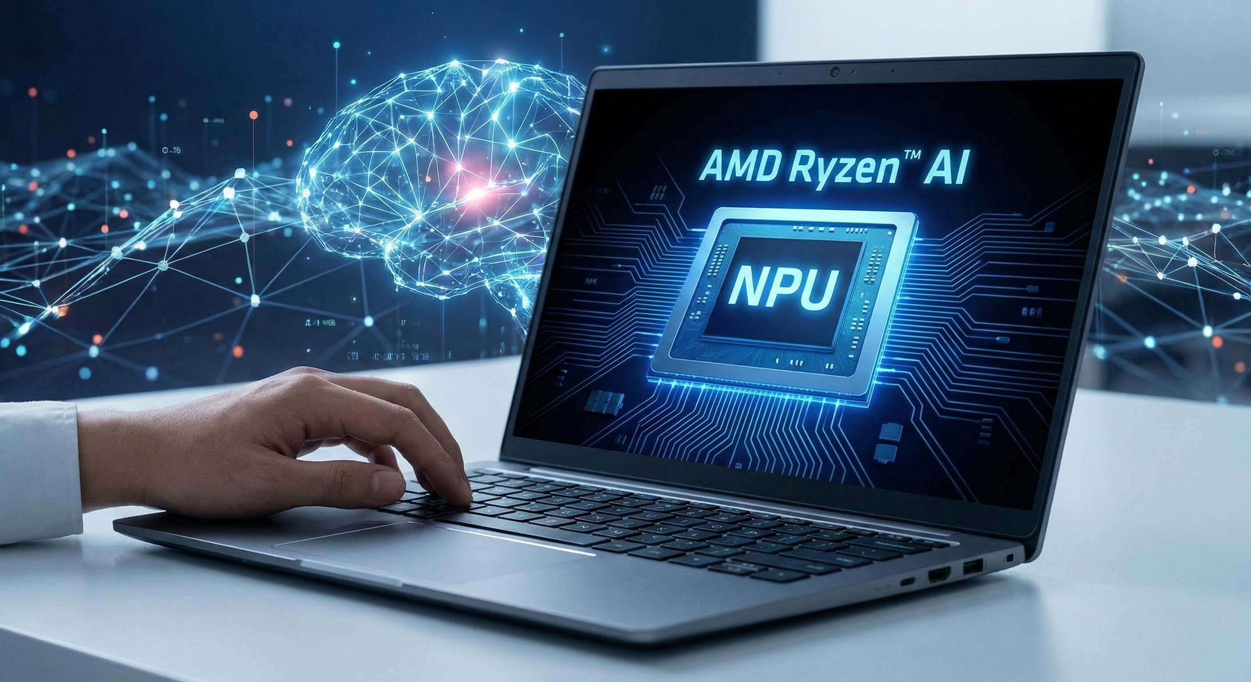
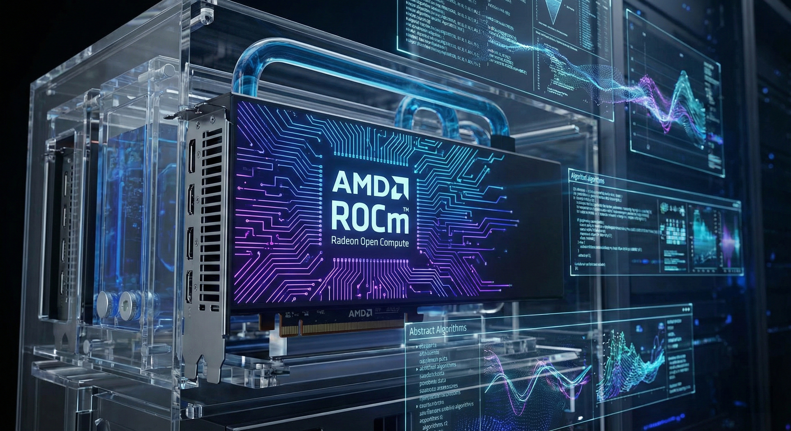
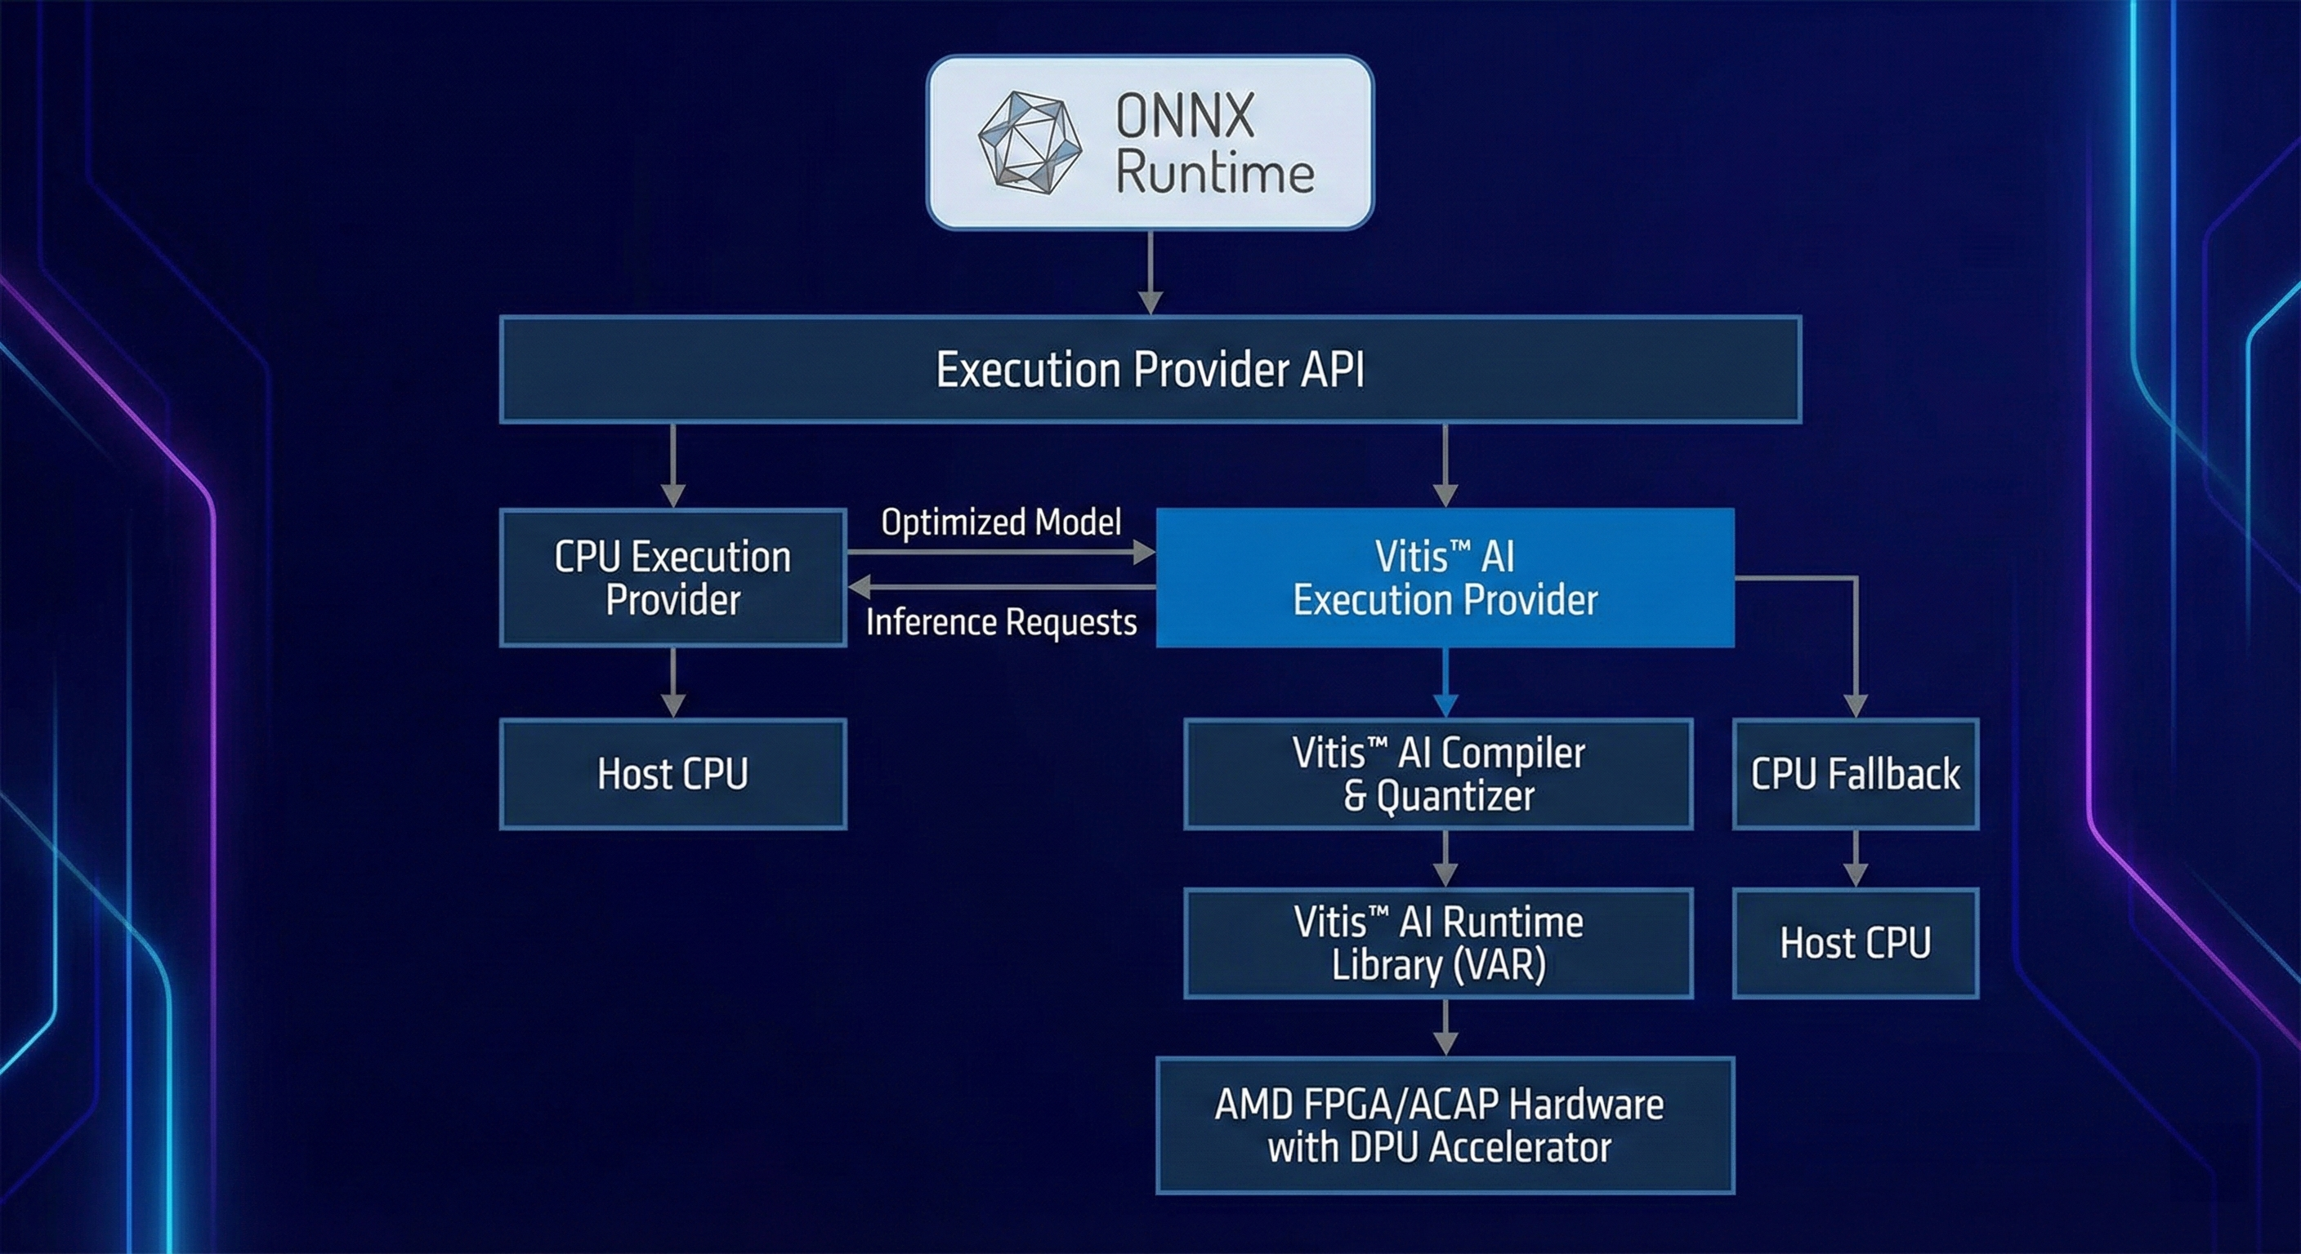
Usage of AMD Products/Solutions
1. AMD Ryzen™ AI (NPU)
Role: The "Green Engine" of our application.
Usage: For instance, the task involving real-time object detection (YOLOv8) and waste classification was migrated from a power-hungry GPU to a power-efficient Neural Processing Unit (NPU).
Impact: This enables Zero-Carbon Inference, reducing the required power per scan down to milliwatts, allowing the app to run for the whole day using a student's laptop battery.
2. AMD ROCm™ (Radeon Open Compute)
Role: The Optimization Platform.
Usage: We used ROCm open software stack to fine-tune and quantize the Small Language Model (SLM) for "Reasoning Agent."
Impact: It helped accelerate our development cycle. We could deploy a high-performance 'Reasoning Agent' locally without needing a large cloud cluster.
3. ONNX Runtime with Vitis™ AI EP
Role: The Bridge.
Usage: We converted the vision models to ONNX format and executed them with Vitis AI Execution Provider.
Impact: This ensures smooth compatibility along with the maximum performance of our models running with the specific Ryzen AI architecture.

Slide 10
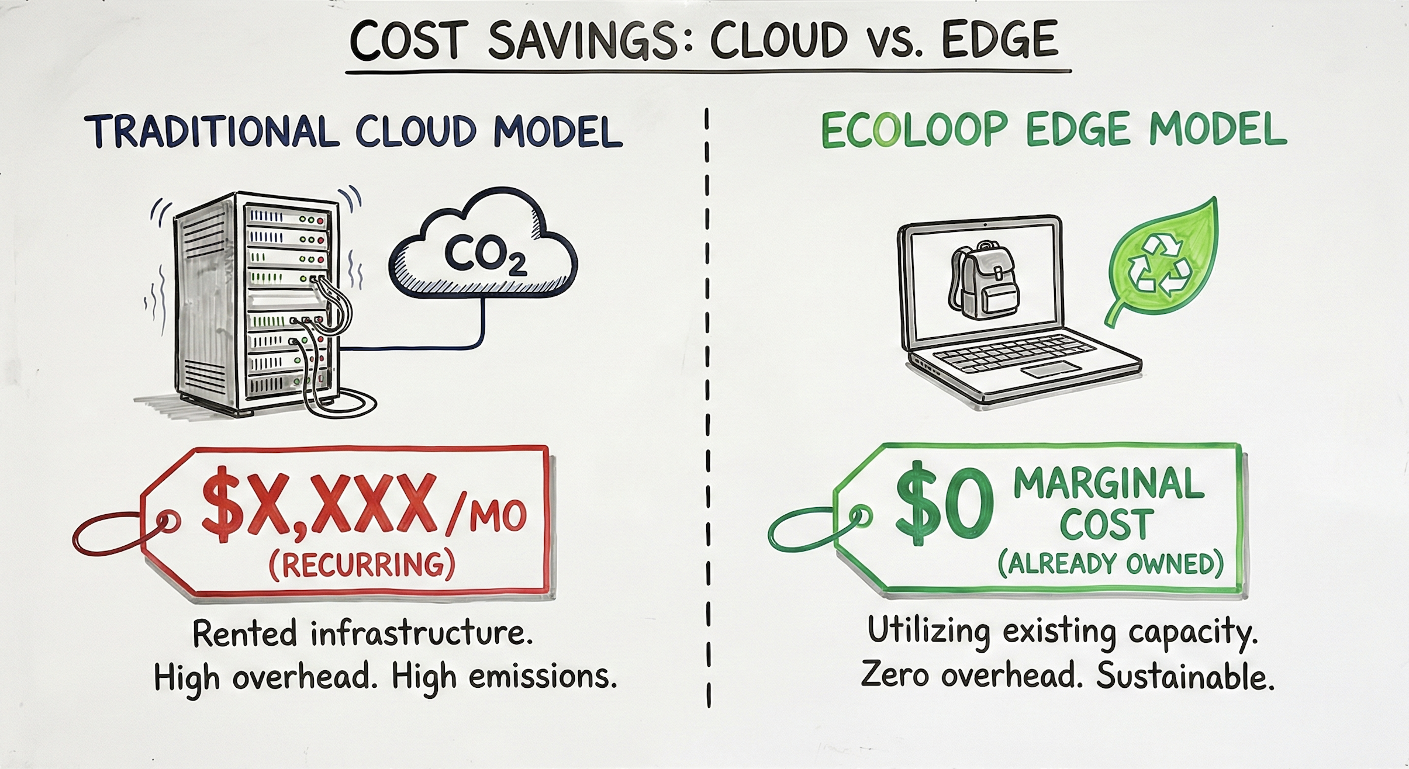
Estimated implementation cost
Zero-Cost "Green" Deployment
1. Infrastructure Cost: $0 (Zero)
Traditional Model: Requires expensive Cloud GPU instances (AWS/GCP) for AI inference -> $500-$1000/month.
EcoLoop Model: Runs 100% locally on user devices (Edge Computing) using the AMD Ryzen AI NPU.
Result: No server bills for the university.
2. Development Tools: Open Source
AI Models: YOLOv8 (Open Source), Phi-3/Llama-3 (Open Weights).
Frameworks: PyTorch, ONNX Runtime, React Native (All Free/Open Source).
Acceleration: AMD ROCm™ (Open Platform).
3. Hardware Requirement: Existing Assets
We leverage the existing laptops and smartphones of students.
No new sensors or IoT devices need to be purchased by the campus administration.
4. Total Estimated Cost to University
$0 (Capex/Opex) for the software platform.
The only "cost" is student engagement and awareness campaigns.

Slide 11
Prototype Assets (Optional)
GitHub Public Repository Link
Demo Video Link (Max: 3 Minutes)
Type here

Slide 12
Add as per the requirements of the contest
Type here

Slide 15
